Slide 1

Chapter 5
The Power of Language

Slide 2
Reminders
Quiz #1 (Weekly Session #4) is now available online, and will be accessible until Sunday at 11:59pm
Complete the quiz online → it is open book
The quiz is timed at 50 minutes and must be completed in one sitting (you cannot stop and continue it later)
It covers chapters 1, 2, and 3
The Personality Dimensions assignment is due next Friday, June 7 through the blackboard website
The assignment can be found under the ‘Assignments’ tab → please download the document and answer the questions
It will be checked for plagiarism using SafeAssign

Slide 3
Plagiarism
The Personality Dimensions Assignment is based only on your own experiences and your Personality Dimensions assessment results → no need for outside research or use of outside websites
If you do refer to outside sources, please cite them properly
At the end of the sentence, provide the name of the work/site in brackets and the page number (if applicable) → e.g. I am a bear (Moe 1)
If you borrow specific words from an outside source (or the Personality Dimensions booklet) or you use more than 2 exact words from a source please place those words in quotations marks and cite the source at the end → e.g. Greens value “knowledge and competence” (PD 3)
If, an ONLY IF, you use outside sources other than the PD assessment, please provide a works cited page at the end where you list the sources you used (THIS IS NOT REQUIRED)

Slide 4
Layers of Language
Within the field of Linguistics (the study of language), there are many different areas of emphasis:
Phonetics: Production and perception of sound
Morphology: How sounds combine to make words
Syntax: Ordering words to make sentences
Semantics: Literal meaning of words and sentences
Pragmatics: Meaning of sentences in context
Discourse: the study of language in relation to other social practices within a specific group
Scholars may study some or all of these dimensions

Slide 5
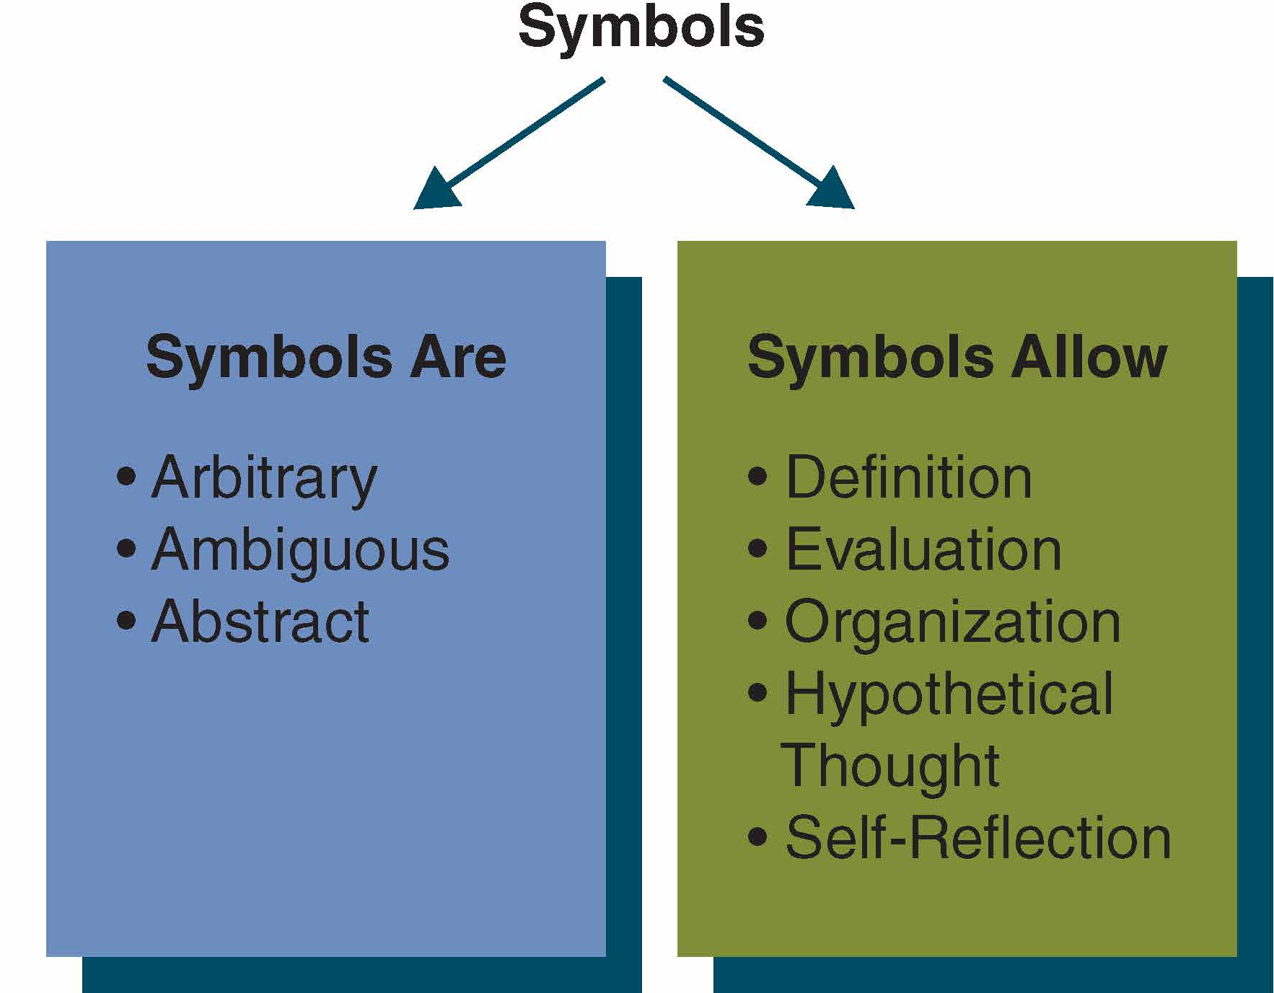
The Symbolic Nature of Language
Symbols are arbitrary, ambiguous, and abstract representations of other phenomena

Slide 6
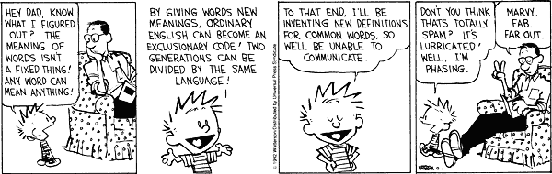
The Symbolic Nature of Language
Arbitrary: words are not intrinsically connected to what they represent → anything can symbolize something else if people accept the meaning
Ambiguous: meanings are not clear-cut or fixed → they change in time and vary by culture
Abstract: language is not concrete or tangible → words/symbols ≠ the thing itself
We can describe an object using labels that reflect different types of categories and levels of abstraction

Slide 7
Principles of Verbal Communication
Language and Culture Reflect Each Other
Culture influences our language (e.g. Adages, “words for rain”), and language can influence culture (e.g. words used to describe member of LGBTQ community)
The Meanings of Language Are Subjective
We are constantly negotiating their meaning

Slide 8
Principles of Verbal Communication (Cont’d)
Language Use Is Rule-guided
Communication Rules are shared understandings of what communication means and what kinds of communication are appropriate in different contexts
Regulative Rules – When, how, where, and with whom to talk about certain things
Constitutive Rules – How to define specific kinds of communication: e.g. friendliness, affection, professionalism, etc.
Communication Devices Shape Meaning
Include pauses, pacing, speed, interruption, etc.

Slide 9
Functions of Symbols
Symbols Define
Labels Shape Perceptions → draws our attention to certain details about people/things while obscuring others
Labels Can Totalize → treat someone as only one, defining label → stereotype
Labels Affect Relationships: help define the relationships and our expectations
Symbols Evaluate
Values in Language Reflect and Shape Perceptions
Language Can Be Negatively Loaded → slant perceptions, meanings negatively
Language Can Degrade Others → hate speech

Slide 10
Functions of Symbols (cont’d)
Symbols Organize Perceptions
Language Allows Abstract Thought → allows us to categorize, generalize and make connections
Language Can Stereotype
Symbols Allow Hypothetical Thought
We Can Think Beyond Immediate, Concrete Situations
We Live in Three Dimensions of Time → past, present, future
We Can Foster Personal Growth
Symbols Allow Self-Reflection
Self-Reflection Allows Us to Monitor Communication
Self-Reflection Allows Us to Manage Our Image

Slide 11
Speech Communities
A speech community exists when people share norms about how to use talk and what purposes it serves. (Labov, 1972)

Slide 12
Speech Communities (cont’d)
Gender Socialization
Social Class
“Race”
Ethnicity
Disability
Sports
Others

Slide 13
Guidelines for Improving Verbal Communication
Engage in Dual Perspective
Own Your Feelings and Thoughts
Respect What Others Say about Their Feelings and Thoughts
Strive for Accuracy and Clarity

